Slide 1
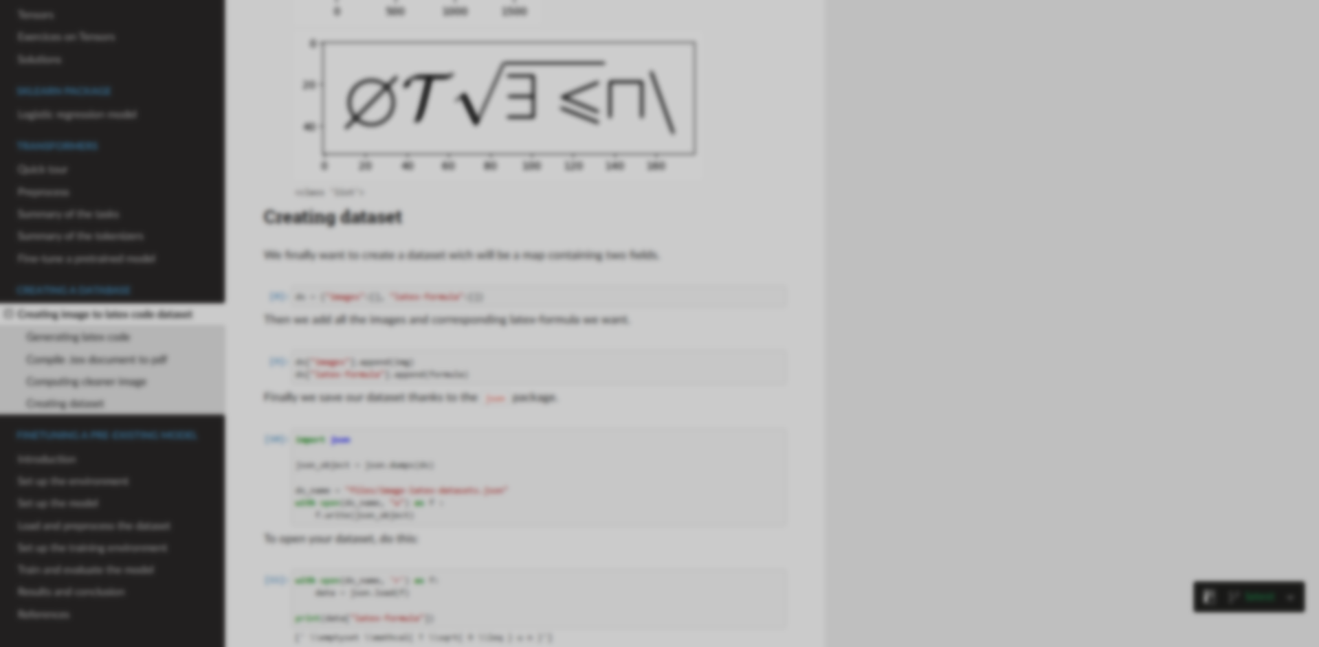
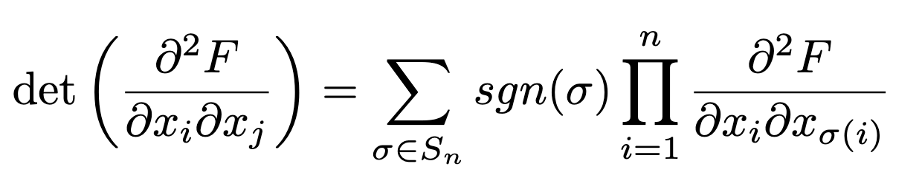
IPdf2Latex
\det\left( \frac{\partial^2 F}{\partial x_i \partial x_j} \right) = \sum_{\sigma \in S_n} \text{sgn}(\sigma)
Macéo Ottavy, Mathieu Longatte, Louison Mocq, Ankit Gayen
Supervised by Simon Delamare

Slide 2
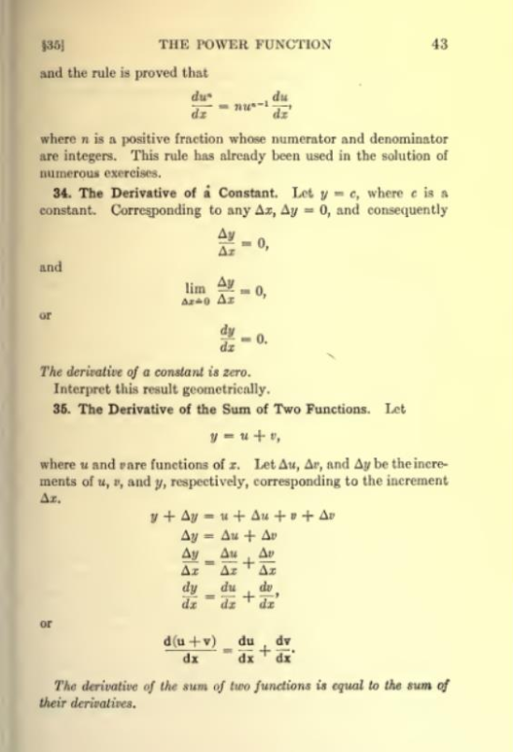
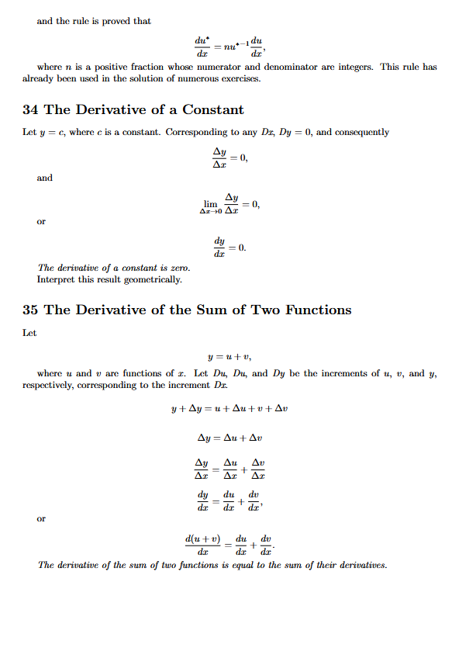
2

Slide 3
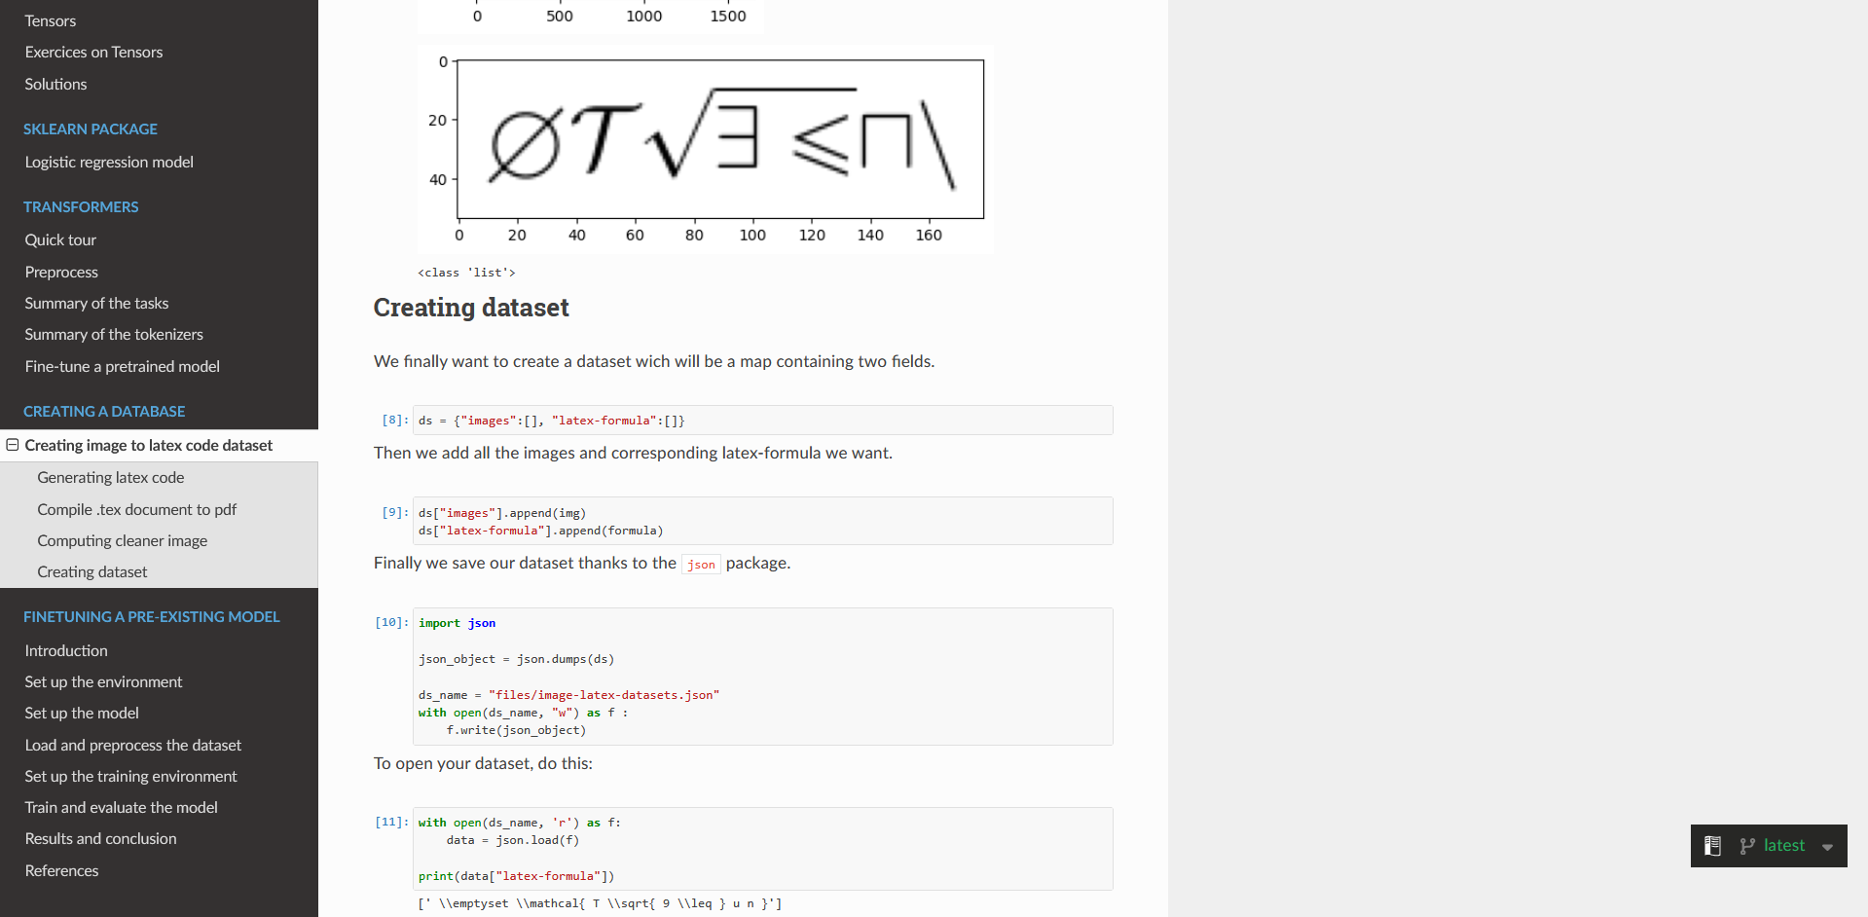
Website
3

Slide 4
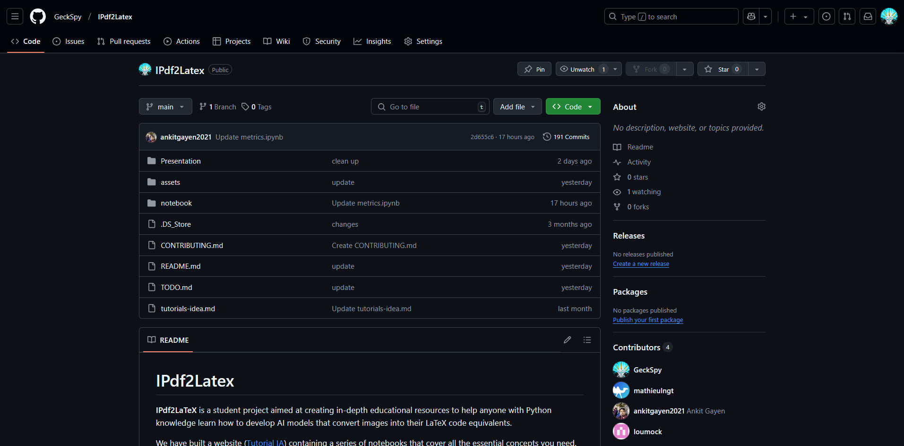
Website
GitHub
3

Slide 5
Objective: Image to Latex
\det\left( \frac{\partial^2 F}{\partial x_i \partial x_j} \right) = \sum_{\sigma \in S_n} \text{sgn}(\sigma) \prod_{i=1}^n \frac{\partial^2 F}{\partial x_i \partial x_{\sigma(i)}}
4

Slide 6
Steps
Step 1: Collect data
Easy: Generate dataset from scratch or arxiv
or take one from Huggingface
Related tutorials: Basics, Images, Loading , Building
5
Notes:
Make notbooks appear, reduce lights on the rest

Slide 7
Steps
Step 1: Collect data
Easy: Generate dataset from scratch or arxiv
or take one from Huggingface
Related tutorials: Basics, Images, Loading , Building
Step 2: Chose a relevant architecture Hard: No obvious structure for Image to text Hard: Language models require a gigantic amount of data
Related tutorials: Curse of Dimensionality, Summary of the tokenizers, Fine-tune a pretrained model
5
Notes:
Make notbooks appear, reduce lights on the rest

Slide 8
Transformers
Objectives :
Capture long distance dependency
Enable parallelization in the treatment
Time :
Person :
Action :
Object :
Goal :
Place :
Yesterday,
Ryan
bought
a red car
to get to his job
in Paris
6

Slide 9
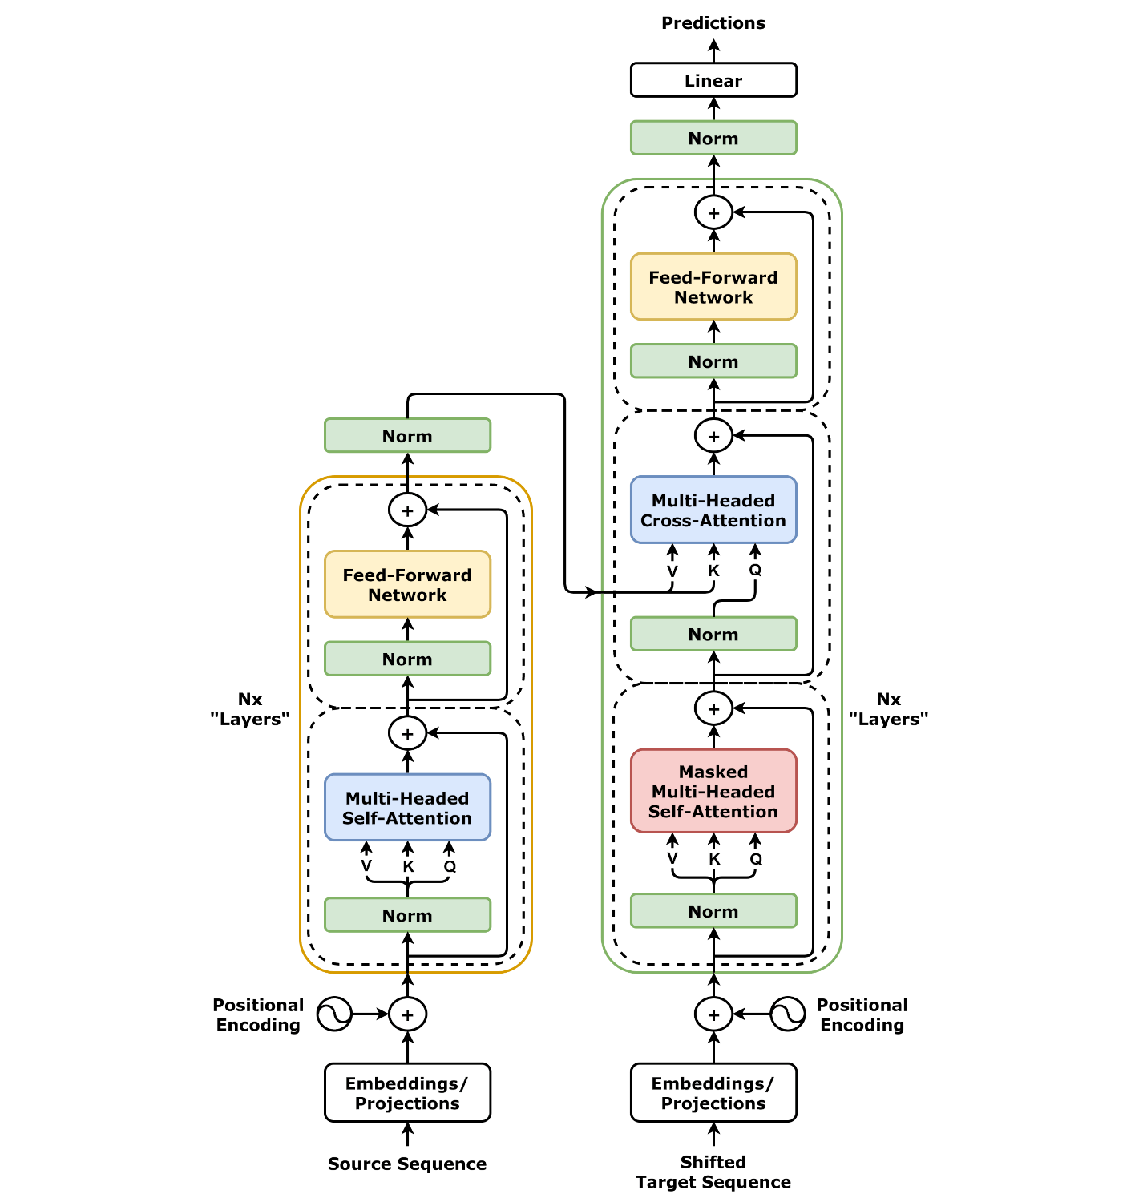
Transformers
7
Related tutorials: Transformers

Slide 10
Transformers
Encoder :
An encoder in AI transforms input data (e.g., text, images) into a compact numerical representation that captures essential features.
7
Swin
Related tutorials: Transformers

Slide 11
Transformers
Encoder :
An encoder in AI transforms input data (e.g., text, images) into a compact numerical representation that captures essential features.
Decoder :
A decoder in AI takes this encoded representation and reconstructs it back into a human-interpretable format, such as text or images.
7
Swin
GPT-2
Related tutorials: Transformers

Slide 12
Steps
Step 1: Collect data
Step 2: Chose a relevant architecture
Step 3: Chose metrics to evaluate the model
BLEU metric
Related tutorials: Introduction to few NLP metrics
8
Notes:
Make notbooks appear, reduce lights on the rest

Slide 13
BLEU metric
BLEU = BiLingual Evaluation Understudy
We are going to predict mathematical formula
9

Slide 14
BLEU metric
BLEU = BiLingual Evaluation Understudy
We are going to predict mathematical formula
Is it good?
Goal of a metric:
Evaluate efficiently the performances of the model
9

Slide 15
BLEU metric
N-gram = sequence of n consecutive words
We are going to predict mathematical formula
10

Slide 16
BLEU metric
N-gram = sequence of n consecutive words
We are going to predict mathematical formula
1-grams:
10

Slide 17
BLEU metric
N-gram = sequence of n consecutive words
We are going to predict mathematical formula
1-grams:
2-grams:
10

Slide 18
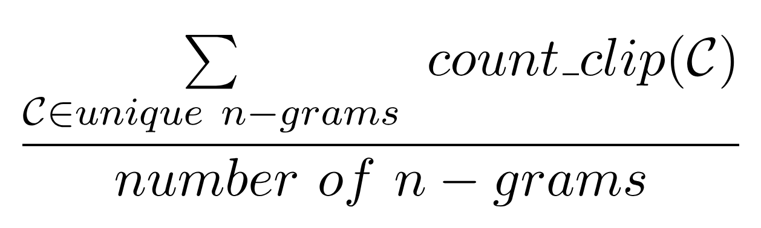
BLEU metric
Modified n-grams:
11

Slide 19
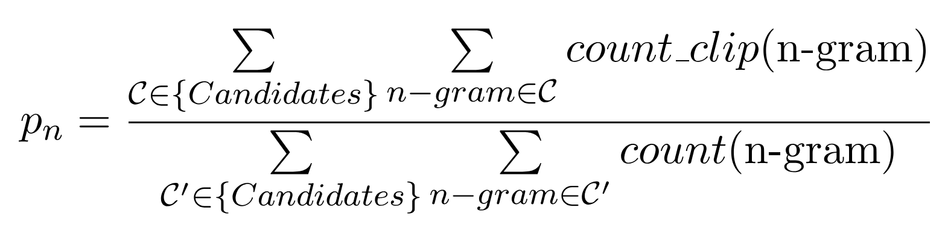
BLEU metric
Modified n-grams:
n-gram precision:
11

Slide 20
BLEU metric
Low 𝑛: Checks the vocabulary of tokens/words used in the candidate
High 𝑛: Checks and ensures proper token order and longer syntactic rules
12

Slide 21
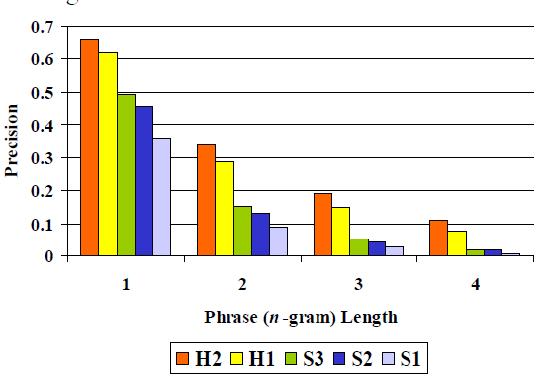
BLEU metric
Low 𝑛: Checks the vocabulary of tokens/words used in the candidate
High 𝑛: Checks and ensures proper token order and longer syntactic rules
12

Slide 22
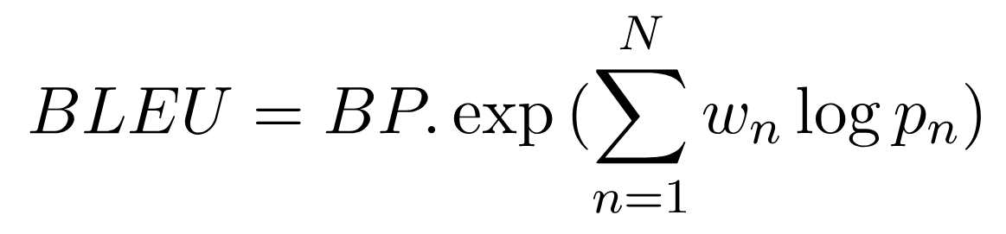
BLEU metric
Low 𝑛: Checks the vocabulary of tokens/words used in the candidate
High 𝑛: Checks and ensures proper token order and longer syntactic rules
12

Slide 23
Steps
Step 1: Collect data
Step 2: Chose a relevant architecture
Step 3: Chose metrics to evaluate the model
Step 4: Chose a relevant programming environment
High view library by Huggingface: Transformers, Trainer
HPC platform: grid5000
13
Related tutorials: finetunin a pre-existing model, Trainer-a PyTorch optimized training loop

Slide 24
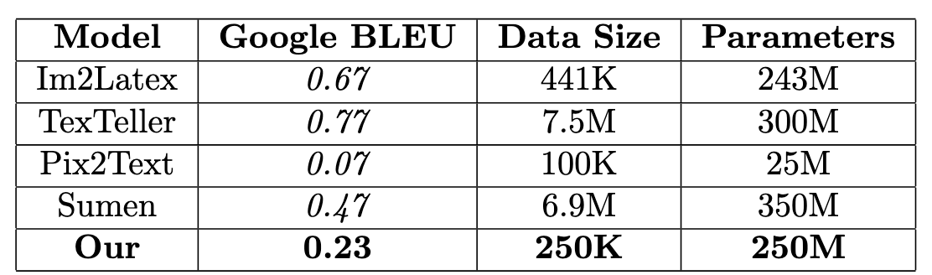
Experiments and Results
Training:
30 hours on 4 GPUs on grid5000
We finetuned 600K paraters among 250M parameters
250K examples on the training dataset, during 3 epochs
Results:
14

Slide 25
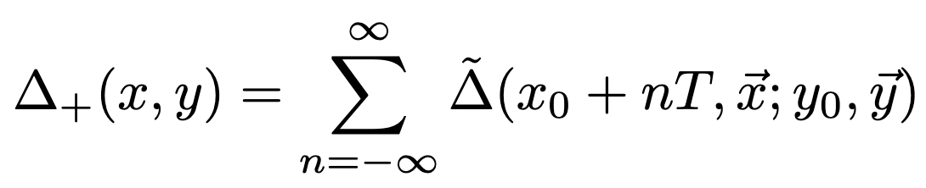
Experiments and Results
Before training
I don't know if it's a coincidence or not," he said. "I think it's just a matter of time before we get to know each other."
He added: "It's not like we're going to be friends. It's just that we're not going to get along very well.
"We're not friends. We're not even friends. I don't think we'll ever get along. I think we're just going to have to get used to each other. We'll just have to figure out how to get through this together. This article is from the archive of our partner .
15

Slide 26
Experiments and Results
After training
{ \Delta } _ { + } ( x , y ) = \sum _ { n = - \infty } ^ { { } } { \tilde { \Delta \left( } x _ { 0 } + n T , { \vec { x } } ; y _ { 3 } ;
{ \bf { y } } \right) } . \ , | {% 1 2 3 5 6 7 8 9 0 4 ^ ( ) x p = y d e g f a b c n t v q z ~ r s o i u w " j l k > / V _ I + J - : } \q A
16

Slide 27
Experiments and Results
After training
{ \Delta } _ { + } ( x , y ) = \sum _ { n = - \infty } ^ { { } } { \tilde { \Delta \left( } x _ { 0 } + n T , { \vec { x } } ; y _ { 3 } ;
{ \bf { y } } \right) } . \ , | {% 1 2 3 5 6 7 8 9 0 4 ^ ( ) x p = y d e g f a b c n t v q z ~ r s o i u w " j l k > / V _ I + J - : } \q A
16

Slide 28
Conlusion
- Model generalizing well
Limitations: Training times, computation power
- Around 30 notebooks covering all project
17

Slide 29
Conlusion
- Model generalizing well
Limitations: Training times, computation power
- Around 30 notebooks covering all project
Futur
Improve model performance
extend to the PDF to Latex tool
provide the associated notebooks
17

Slide 30
IPdf2Latex
Website: https://tutorial-ia-pe.readthedocs.io/en/latest/
GitHub: https://github.com/GeckSpy/IPdf2Latex
Macéo Ottavy, Mathieu Longatte, Louison Mocq, Ankit Gayen
Supervised by Simon Delamare
18

Slide 31
Appendix

Slide 32
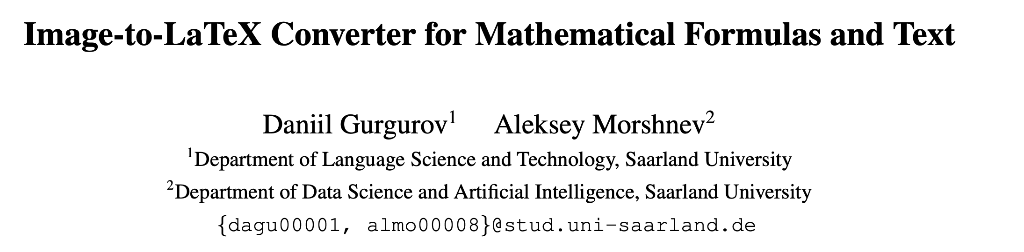
References

Slide 33
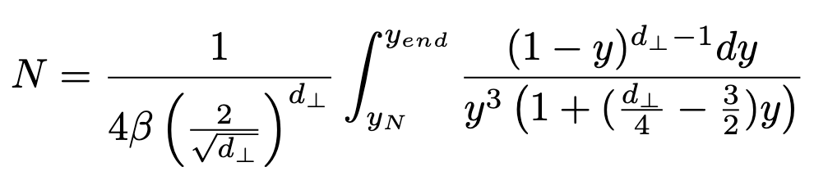
Experiments and Results
After training
N = \frac { 1 } { \beta \Lambda ^ { d - 1 } } \int _ { \mu _ { N } } ^ { \nu _ { 0 } \alpha _ { s } } { ( \frac 2 { \sqrt { d _ { D } } } ) ^ { 2 } \over { y ^ { 3 } \left( 1 + ( 1 + \frac 3 { 4 } - \frac 1 4 ) y \right) } } \ .%: = , ( ) 1 2 - 3 4 5 7 8 9 6 | > { ~ / 0 ^ e p a b c d x r v l s i y h t o k q z n I g f }

